Slide 1

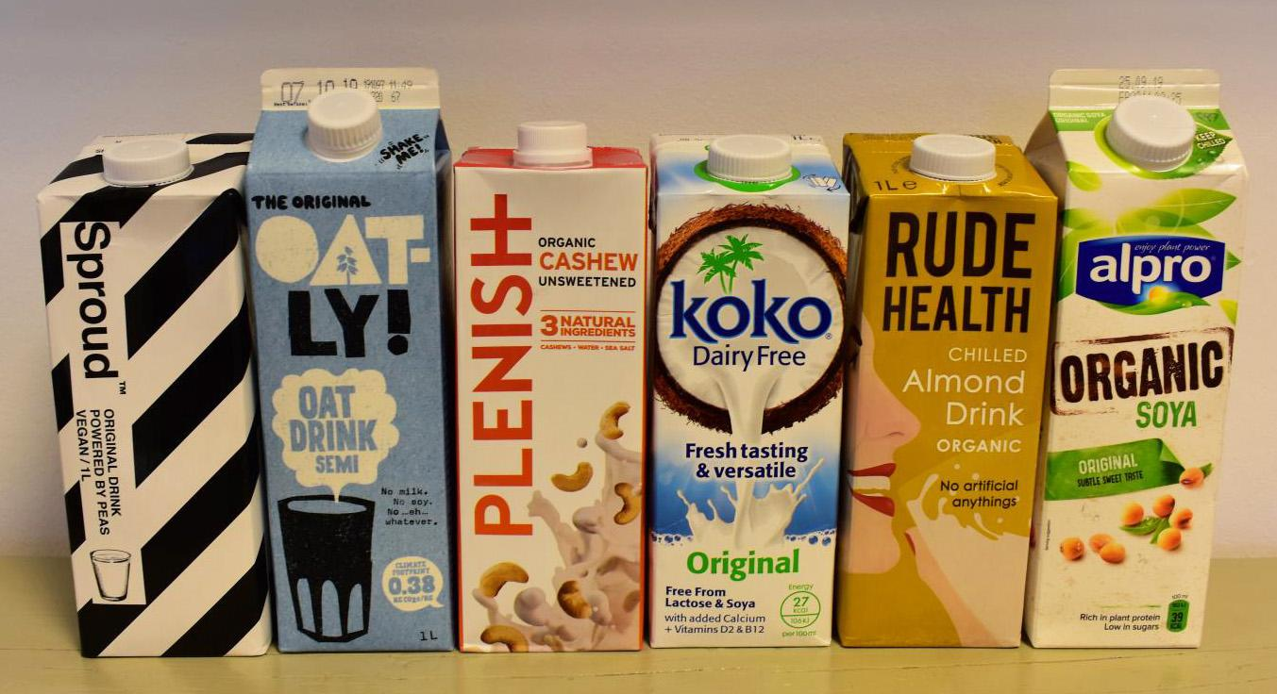

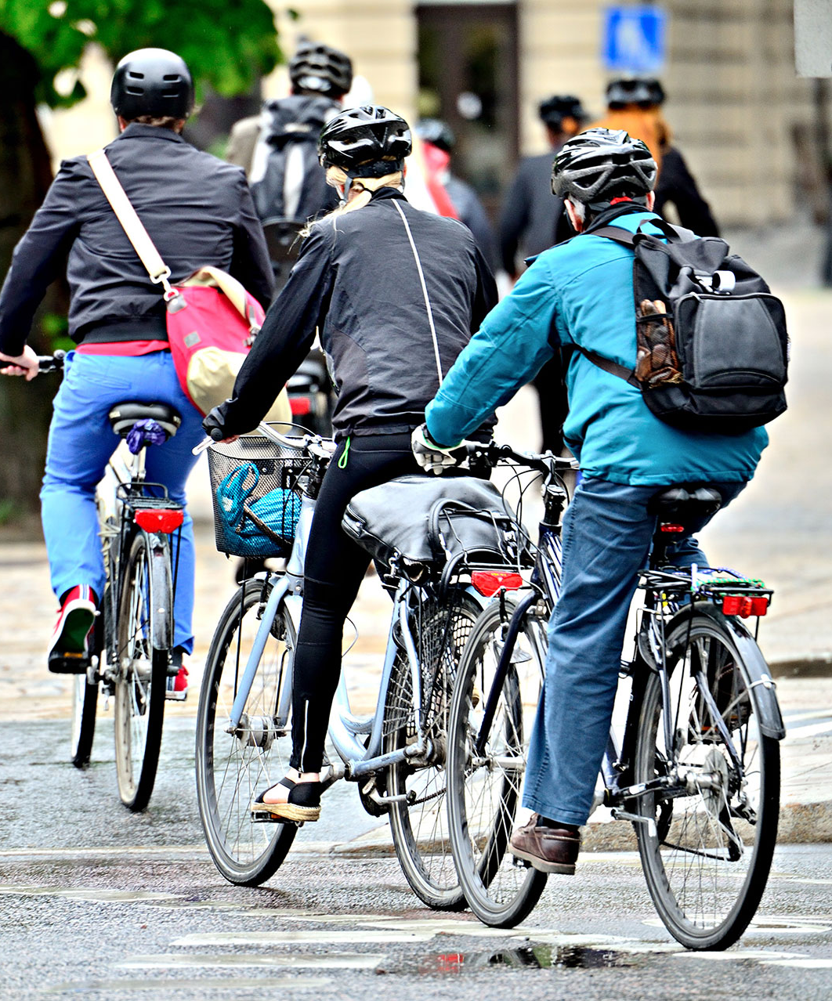
What is going on in these pictures?
Together, these images give us an idea of the things we can do to help reduce/fight climate change.

Slide 2
Do now activity…
From last lesson, what key word would best describe a Christian’s duty to looking after the environment?
What key word describes public interest/wellbeing in Islam?
Give a reason why Buddhists would want to care for the environment.
Stewardship. (Dominion would also come into the discussion).
Maslahah.
1. Ahimsa – not causing harm to living things. 2. The First Precept of not harming other living things. 3. The Noble Eightfold Path – specifically: right intention, right livelihood, right action.

Slide 3
Climate Change Lesson 4: What can we do?
Learning Intention: To understand what we can do to reduce climate change.
Success criteria 1: To understand that we can make changes in our lives to reduce climate change.
Success criteria 2: To experience one thing we can do – chocolate!
Success criteria 3: To complete a “diamond 9” on things we can do.

Slide 4

Success criteria 1: To understand that we can make changes in our lives to reduce climate change.
Watch the video to understand your “carbon footprint”…
Write your own definition of “carbon footprint”.
Climate Change: Your carbon footprint explained - BBC News - YouTube
If you’re struggling, here’s a definition…
“A carbon footprint is the total amount of greenhouse gases (including carbon dioxide and methane) that are generated by our actions.”
ANSWER: Richer countries have more money to consume more. (E.g. technology, clothes, flights, cars etc.)
CHALLENGE: Why do richer countries tend to have bigger carbon footprints?

Slide 5

Success criteria 1: To understand that we can make changes in our lives to reduce climate change.
Reflection point.
Write down your thoughts in your book.
(In full sentences).
What actions in your life do you think contribute to your carbon footprint?
Do you think you have a higher carbon footprint than people in your school?
Do you think it would be easy to reduce your carbon footprint?

Slide 6


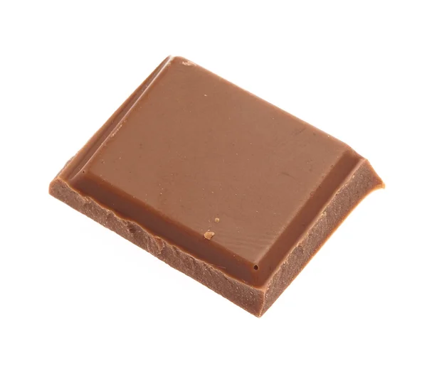

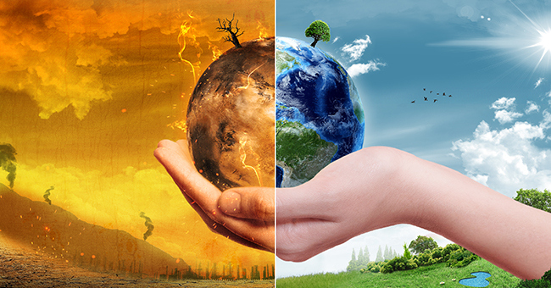
Success criteria 2: To experience one thing we can do – chocolate.
As we have seen over the last few lessons, climate change is caused by human choices. In a moment you’ll make a choice that represents the choices we make everyday.
You will have the choice between one piece of “climate change friendly” Rainforest Alliance or Fairtrade chocolate, or two pieces of “normal” chocolate.
What will you pick?

Slide 7
Success criteria 2: To experience one thing we can do – chocolate.
Answer these questions in full sentences.
Did you choose one piece or two?
Why did you make that decision?
Did you feel guilty or pressured to pick a certain one?
What do you think Christians, Buddhists or Muslims might say about people who chose two? (What caused them to do it?)
Are there choices you make everyday that impact the climate? If so, could you make a change?
Notes:
Q4: temptation from devil, original sin, weakness, greed, ignorance, craving, lack of care for others. Maslahah.

Slide 8

Success criteria 3: To complete a “diamond 9” on things we can do.
You now need to complete the “diamond 9” with 9 things we can do to help reduce climate change.
You can swap one or two of your own if you have thought of something over the last few lessons.
Most achievable
Switch to plant based milk.
Reduce meat consumption.
Buy less clothes.
Eat chocolate from sustainable manufacturers.
Avoid/reduce flying on a plane.
Waste less food.
Don’t waste energy at home e.g. lighting and heating.
Recycle more items –even difficult ones!
Buy less toys/things.
Take shorter showers.
Least achievable

Slide 9
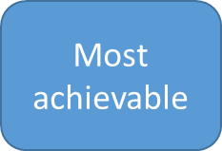
Most achievable
Least achievable
Least achievable
Notes:
Blank diamond 9 to print.

Slide 10
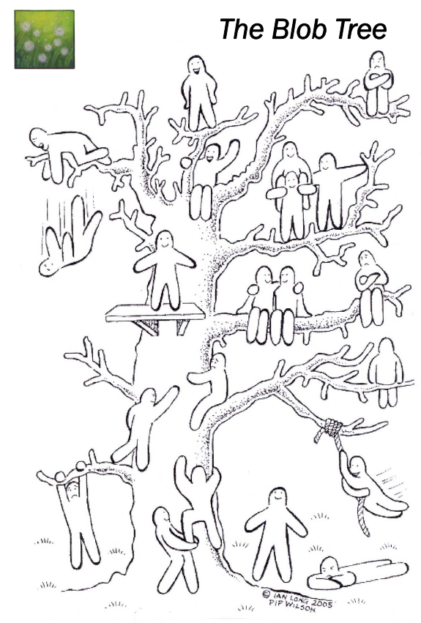

Based on the blob tree, how do you feel after today’s lesson and why?
Pick a blob for your understanding of the work and a pick another blob for your feelings about today’s topic.

